Slide 1
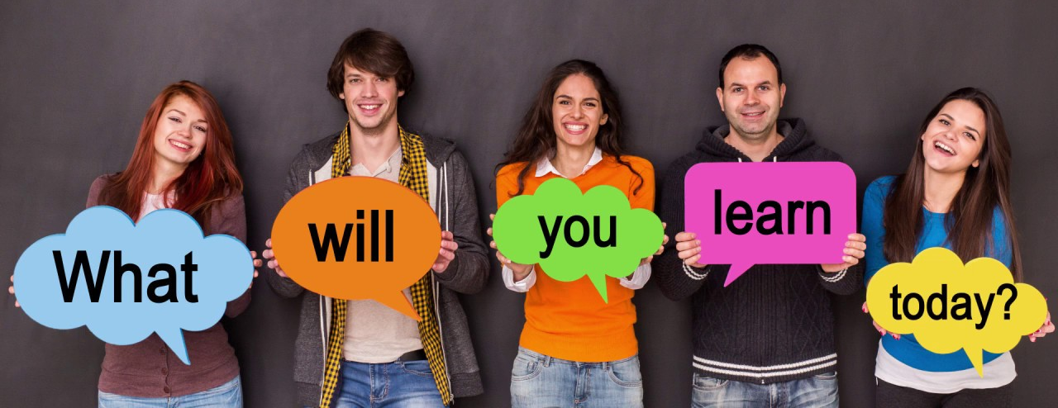
Layout complicated views
In this lession, you will learn:
- Build some ListView layouts using ForEach
- Make ListViewItem clickable
- Build GridView with customized components
- Change states(list of objects) when user click to ListView Item
- Customize UI of list items

Slide 2
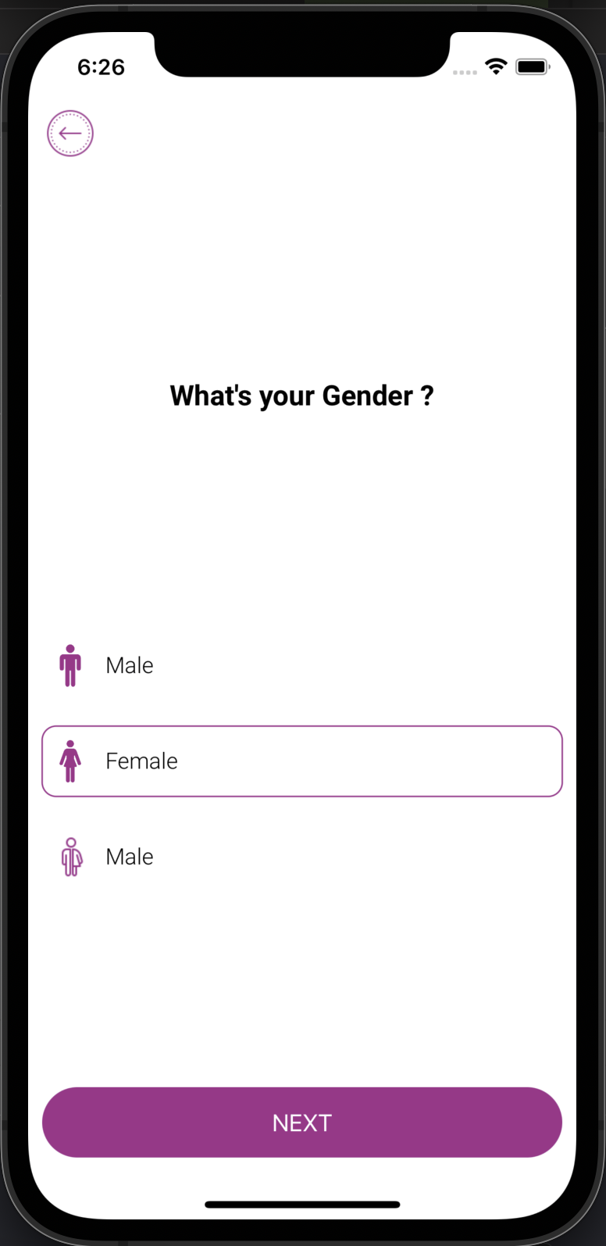
Example of a ListView
Write a Component using FlatList:
- User can only select one row
- Data is fetched from a list of objects
- Icons are “png” images which have foreground colors
- Donot use ListView or other library

Slide 3
Build your own List View
//Identifiable is a protocol("interface") which must implement "id" property
struct Gender : Identifiable{
let icon: String
let text: String
var isSelected: Bool
//conform to Identifiable
var id:String {icon}
}
//States as a list of objects
@State private var genders:[Gender] = [
Gender(icon: Icons.male,text: "Male",isSelected: false),
Gender(icon: Icons.female,text: "Female",isSelected: false),
Gender(icon: Icons.nonBinary,text: "Male",isSelected: true)
]
//isSelected = true / false

Slide 4
Put your List View inside Views
//If you have many items inside Group, let's group it, otherwise it may encounter errors
Group {
Spacer()
Text("What's your Gender ?")
.frame(maxWidth: .infinity, alignment: .center)
.font(Font.custom("Roboto-Bold", size: 20))
.padding()
Spacer()
}
Group {
ForEach(genders) { gender in
//List item here...
}
}

Slide 5
Fetch data to your List View
import SwiftUI
HStack(spacing:10) {
Image(gender.icon)
.renderingMode(.template)
.resizable()
.aspectRatio(contentMode: .fit)
.frame(height: 30)
.foregroundColor(Colors.primary)
Text(gender.text)
.font(Font.custom("Roboto-Light", size: 16))
Spacer()
}
.padding(.vertical, 10)
.padding(.leading, 5)
.overlay(
RoundedRectangle(cornerRadius: 10)
.stroke(Colors.primary, lineWidth: gender.isSelected ? 1 : 0)
)
.padding(.leading, 10)
.padding(.trailing, 10)
.padding(.vertical, 5)
}

Slide 6
Make list item clickable
.onTapGesture {
genders = genders.map({ eachGender in
var changedGender = eachGender
changedGender.isSelected = eachGender.icon == gender.icon
return changedGender
})
Button(action: {
}) {
Text("NEXT")
.frame(maxWidth: .infinity, minHeight: 50)
.foregroundColor(.white)
.background(Colors.primary)
.clipShape(RoundedRectangle(cornerRadius: 25))
.padding(.leading, 10)
.padding(.trailing, 10)
}.padding(.bottom, 10)

Slide 7
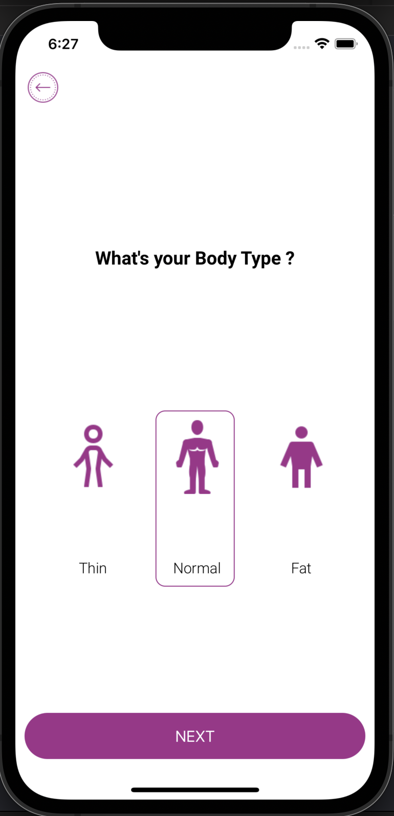
Build your own Horizontal List
Build a Horizontal List:
Donot use ListView or other library
- User can only select one row
- Data is fetched from a list of objects
- Icons are “png” images which have foreground colors

Slide 8
States of Horizontal List
struct BodyType : Identifiable{
let icon: String
let text: String
var isSelected: Bool
//conform to Identifiable
var id:String {icon}
}
@State private var bodyTypes:[BodyType] = [
BodyType(icon: Icons.bodyShapeThin,text: "Thin",isSelected: false),
BodyType(icon: Icons.bodyShapeNormal,text: "Normal",isSelected: false),
BodyType(icon: Icons.bodyShapeFat,text: "Fat",isSelected: true)
]
//isSelected = true / false

Slide 9
Map object’s list to UI
//this HorizontalStack has full-width
Group {
HStack {
ForEach(Array(bodyTypes.enumerated()), id: \.offset) { index, bodyType in
//body type's objects here
}
}
.frame(maxWidth: .infinity, maxHeight: 200, alignment: .center)
}
//isSelected = true / false

Slide 10
Fetch data to your ListItem
VStack {
Image(bodyType.icon)
.renderingMode(.template)
.resizable()
.aspectRatio(contentMode: .fit)
.frame(width: 80)
.foregroundColor(Colors.primary)
Spacer()
Text(bodyType.text)
.font(Font.custom("Roboto-Light", size: 16))
}
.padding(.vertical, 10)
.padding(.leading, 5)
.overlay(
RoundedRectangle(cornerRadius: 10)
.stroke(Colors.primary, lineWidth: bodyType.isSelected ? 1 : 0)
)
.padding(.leading, 10)
.padding(.trailing, 10)
.padding(.vertical, 5)

Slide 11
Make your List Item clickable
VStack {
//...
}
.onTapGesture {
bodyTypes = bodyTypes.map({ eachGender in
var changedGender = eachGender
changedGender.isSelected = eachGender.icon == bodyType.icon
return changedGender
})
}

Slide 12
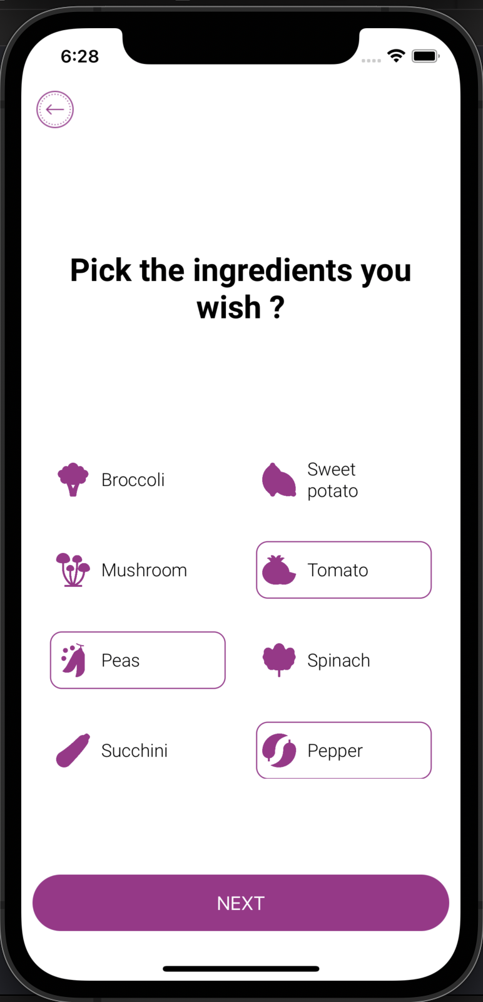
Build a Grid View and multiple choices
Build a GridView like this:
- Use LazyVGrid or other library
- User can only select multiple items
- Data is fetched from a list of objects
- Icons are “png” images, make sure that they have the same dimensions

Slide 13
Objects of the LazyVGrid
@State private var ingredients:[Ingredient] = [
Ingredient(
icon: Icons.broccoli,
text: "Broccoli",
isSelected: false
),
Ingredient(
icon: Icons.sweetPotato,
text: "Sweet potato",
isSelected: false
),
Ingredient(
icon: Icons.mushroom,
text: "Mushroom",
isSelected: false
),
//..other objects
]
let selectedIngredients = ingredients.filter {
$0.isSelected == true
}

Slide 14
Build the LazyVGrid(parent Views)
UIHeader(
onPressLeft: {
print("left")
}, onPressRight: {
print("right")
}, title: "")
Group {
Spacer()
Text("Pick the ingredients you wish ?")
.frame(maxWidth: .infinity, alignment: .center)
.multilineTextAlignment(.center)
.font(Font.custom("Roboto-Bold", size: 28))
.padding()
Spacer()
}
Group {
ScrollView {
LazyVGrid...
.frame(maxHeight: 300)
}

Slide 15
GridView = LazyVGrid + columns
let columns = [
GridItem(.adaptive(minimum: 100)),
GridItem(.adaptive(minimum: 100))
]
Group {
ScrollView {
LazyVGrid(columns: columns, spacing: 10) {
//some code here
}
.padding(.horizontal)
}
.frame(maxHeight: 300)
}

Slide 16
Build the detail FlatList
LazyVGrid(columns: columns, spacing: 10) {
ForEach(ingredients) { ingredient in
//ListView item code here
}
}
HStack(spacing:10) {
Image(ingredient.icon)
.renderingMode(.template)
.resizable()
.aspectRatio(contentMode: .fit)
.frame(height: 30)
.foregroundColor(Colors.primary)
Text(ingredient.text)
.font(Font.custom("Roboto-Light", size: 16))
Spacer()
}
.padding(.vertical, 10)
.padding(.leading, 5)
.overlay(
RoundedRectangle(cornerRadius: 10)
.stroke(Colors.primary, lineWidth: ingredient.isSelected ? 1 : 0))

Slide 17
LazyVGrid’s item Events
.onTapGesture {
ingredients = ingredients.map({ eachIngredient in
var changedIngredient = eachIngredient
changedIngredient.isSelected = changedIngredient.icon == ingredient.icon ? !changedIngredient.isSelected : changedIngredient.isSelected
return changedIngredient
})
}
Button(action: {
print("haha")
}) {
Text("NEXT")
.frame(maxWidth: .infinity, minHeight: 50)
.foregroundColor(.white)
.background(selectedIngredients.count > 0 ? Colors.primary : Colors.inactive)
.clipShape(RoundedRectangle(cornerRadius: 25))
.padding(.leading, 10)
.padding(.trailing, 10)
}.padding(.bottom, 10)
.disabled(selectedIngredients.count == 0)

Slide 18


